Slide 1
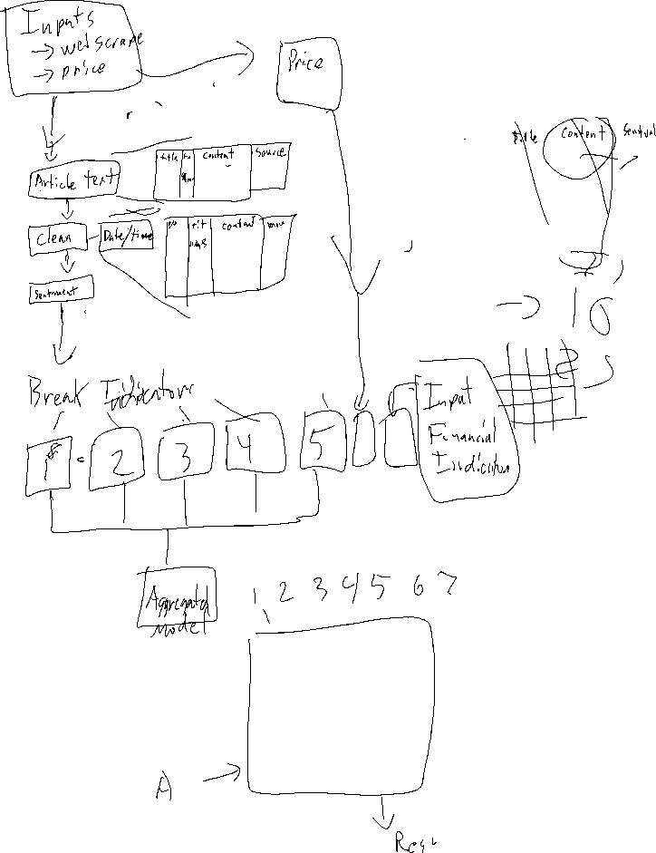

Slide 2
Server
Websites
Scraper
Text Cleaning
Price Query
Translate
Exchange API
Date Cleaning
Price Query
Concatenation
Predictor Query
Additional Predictors
Split DF Into Separate Predictor DFs
Sentiment Analysis
Client
Sentiment Predictors Compiled
Additional Predictors
User Input
I₁
I₂
I₃
I₄
I₅
I₆
I₇
I_{N}
NN Model
Market Prediction + Confidence
Current Wallet Positions
Exchange API
Buy/Sell Function
Execute Trade
Exchange API
Status Function
Monitor Trade Status
Output Status
Client
History
Charts
Summary

